Slide 1



RSM Defense Overview
PRIVATE AND CONFIDENTIAL
Managed Threat Detection and Response
2024

Slide 2

Strength in numbers
RSM International
$9.4B revenues in calendar 2023
820 offices
64,000 people
120 countries
Combined RSM US and RSM Canada
Revenue mix
$3.7B revenue in fiscal 2023
1,150 partners and principals in fiscal 2023
15,462 employees in fiscal 2023
38%
33%
28%
1%
Consulting
Tax
Assurance
Other
Notes:
Key Points:
RSM Risk Consulting has global reach and scale
We’re a full-service accounting and consulting team, and bring full firm to serve clients
We’re continuing to grow and build out international risk consulting capabilities

Slide 3


RSM Cyber | Meeting our clients where they need us most
Assess
Advise
Implement
Manage
SERVICES
Attack Surface Management
Identify and reduce attack surface through continuous proactive management
Vulnerability management
Penetration testing & red teaming
Asset discovery and management
Technical cyber compliance programs
Resilience & Recovery
Understand cyber resilience obligations and prioritize recovery operations
Impact analysis
Business continuity & disaster recovery
Application & system rationalizations
Third party risk management
Secure Cloud
Embark on your cloud journey in a controlled and secure manner
Cloud posture management
Platform design, development and deployment
Secure operations and administration
Cloud infrastructure entitlements management
Architecture & Engineering
Manage the risks of today’s boundary-less environment
IoT and operational technologies
Industrial control systems
Zero-trust and enterprise architecture
Standards and runbooks
Cyber solution engineering
Security tools & technologies
Application
Security
Drive secure practices throughout the application development lifecycle
SecDevOps
Secure code analysis
Web app security testing
Secure design principles
Data classification & protection
Continuous penetration test
Detect & Respond
Effectively and efficiently identify and quickly respond to incidents
RSM DefenseTM – managed security
Security operations
Threat intelligence
Digital forensics & incident response
Endpoint detection & response
Strategy & Risk
Design and implement transformative cyber programs
Maturity and risk assessments
Policies and procedures
Program design and management
Framework design
Virtual CISO
Security awareness training
Cyber workforce development
Compliance & Governance
Decipher framework, regulations and standards compliance
Assurance, accreditation, and certification (i.e., PCI, FedRamp, CMMC, HiTrust, etc.)
Third-party risk
Governance, risk & compliance (GRC)
Privacy
Digital Identity
Securely manage human and device identities across your universe
Governance & administration
Privilege access
Authentication & authorization
Identity threat detection & response
User behavior analytics
Emerging
Technologies
Making sense of security implications from technology innovations to prioritize resources
Artificial Intelligence
Autonomous vehicles
Metaverse & augmented reality
Virtual power plants (VPP)
Notes:
Daniel

Slide 4
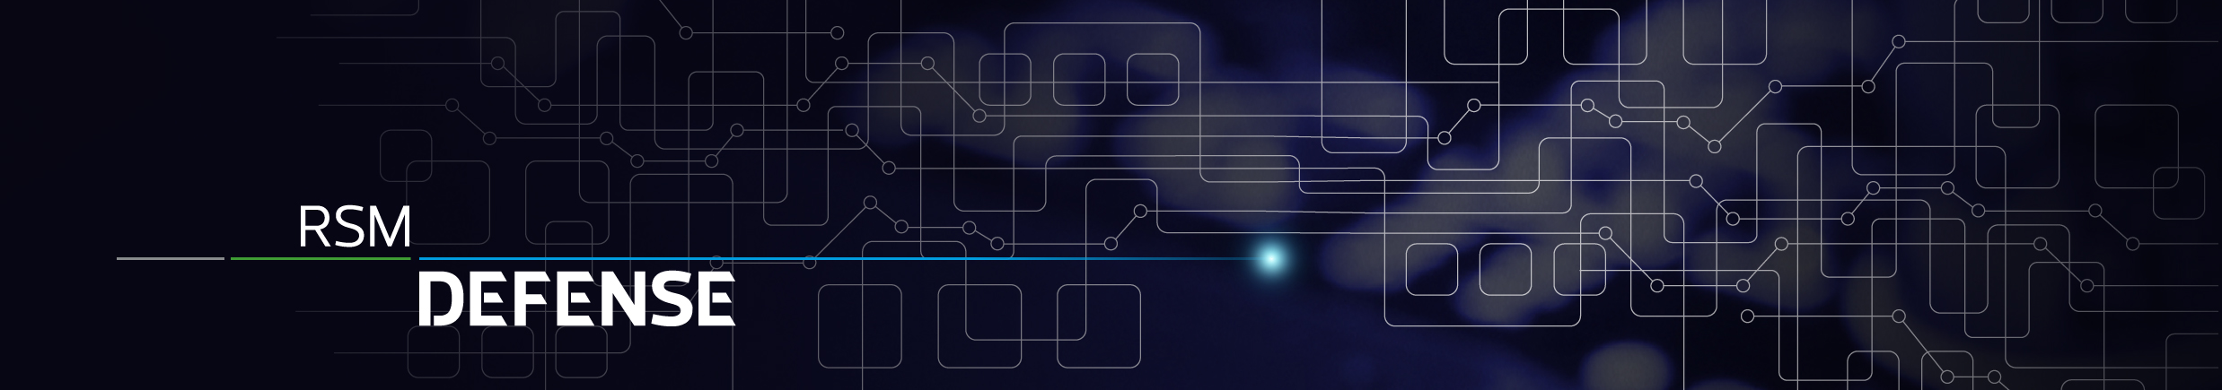








Elevating managed security
ALWAYS ON
FOREVER VIGILANT
INFORMED RESPONSE
24x7 security analysts monitoring our clients’ environments for suspicious and confirmed threats
Leveraging automation workflows, reducing MTTD and dwell time for our clients to speed in faster response and recovery
Threat intelligence is integrated into everything we do, aids in prioritizing risks, and determining the correct course of action
CAPABILITIES
Security event monitoring
Attack surface reduction
Threat intelligence
Network Traffic Analyses
Real-time security monitoring of client environments, correlating events, and analyzing potential threats leveraging our SaaS XDR Service
Fully managed vulnerability capabilities include continuous scanning, file, and configuration monitoring, false positive analysis, and detailed remediation actions.
Fully integrated intelligence sources help influence the decision-making process for our analysts.
Collecting NetFlow to provide additional intelligence in threat investigations
Automated response
Endpoint security
IoT/device monitoring
Brand safeguarding
Leveraging automated playbooks, we can perform predefined scripted remediation activities
Identifying risks, behaviors, and anomalies affecting your endpoints. Continuous hunting, tuning, and informed response.
Providing threat monitoring of clients ICS environments utilizing a lightweight collector meant for plant and healthcare environments
Monitoring cybersquatting activity and protecting your domain name from typo-squatting to safeguard your reputation

Slide 5




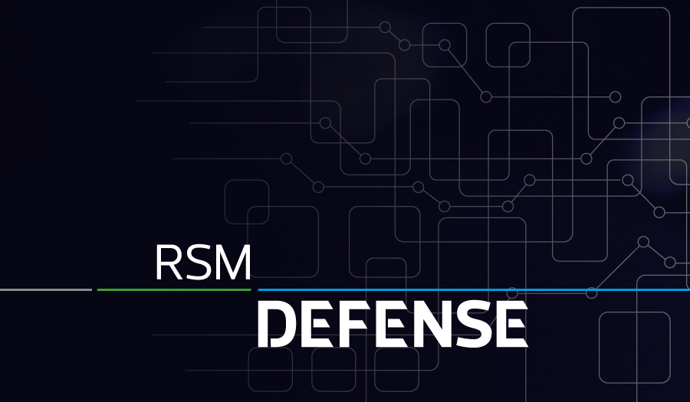




10,000 daily threats detected and blocked
40,000 unique threat indicators
150K+ endpoints and assets managed
75
collective years delivering managed security solutions
250 security professionals
900+ cybersecurity clients nationally
Security professionals in countries
29

Slide 6






Day In The Life | Threat detection
RSM SOC – Incident Alert & Response Procedure
Log sources
Telemetry
400 SOC Procedures
Robust Quality Control
Pre-Approved Research Sources
Tuning
Automation
Enrichment
Knowledge Base
Threat intelligence
Vulnerability Scan
Threat
Analyst Quarterback
Escalate & Engage
Remediate
Review
Recommend
Continuous improvement:
Automation Candidate
Correct Remediation Tactic
Tune OR Augment Rulesets
Investigate
SOC analyst receives alert
False Positive
Query Threat Intel
RSM analyst
RSM analyst
Operations team
RSM analyst
RSM QC
Alert Triggered
Triage – Collect Additional Context
Notify & Remediate
After-Action Report /
Close loop feedback
Closing and Continuous Improvement

Slide 7




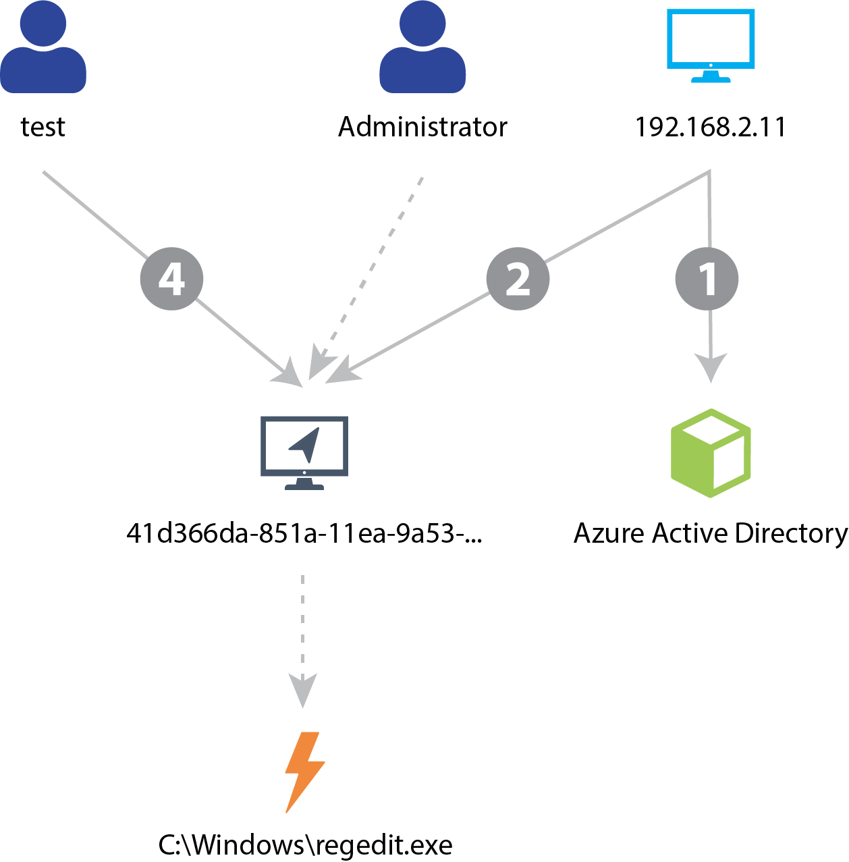




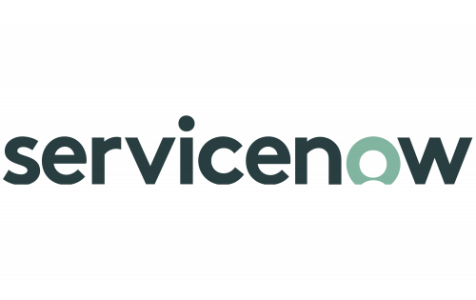
RSM Defense Tech Stack
Entire Enterprise Attack Surface Collection
SENSORS
Normalized, Enriched Data
RSM DEFENSE
Multi Method Detections
ML-Based Incident Correlation
THREAT INTEL
Investigation & Intelligent Response
!
NETWORK
XDR Portal
KNOWN BAD
ENDPOINT
!
YOUR TOOLS
CLOUD
UNKNOWN BAD
IT / Security Service Management
LOCATION
ASSET USER CONTEXT
IDENTITY
APPS

Slide 8




Fully managed NG-XDR service offering
Extended Detection & Response
24x7 Security Operations
Threat Hunting & Tuning
Incident / Case Handling
Mature Documented Procedures
Custom Threat Intelligence Subscriptions
Vulnerability Management
Weekly scanning / Monthly Reporting
Endpoint, Network, Cloud Visibility
Measurable Program Results
Custom Remediation Options
Endpoint Detection & Response
Fully managed EDR or BYO
Signature & Behavior Detection
SOAR Automation – Drop, Disable, Contain
Network Detection & Response
Network Traffic Analyses
Deep Packet Inspection / Blocking
Behavior Analysis / Certificate Inspection
Configuration Monitoring
Privacy Framework
Security Framework
Training & Phishing
KnowBe4 Platform
Fully Customized
Measurable Program Results

Slide 9
XDR Threat Detection Service

Slide 10









XDR Service
Extended Detection & Response (XDR), All-in-One Security Operations services.
Turnkey detection and response service to ingest, enrich, contextualize, hunt, and respond with 100% threat visibility. Block hot and fast attacks. Detect slow burn attacks. Respond with decisive actions 24x7x365.
SIMPLE FIREWALL
DEFENSE IN DEPTH
XDR
MATURITY
Single Platform, Detect, Correlate, & Respond
FIREWALL
IAM
SIEM
ENDPOINTS
Outcomes
THREAT HUNTING
RISE OF CORRELATIONS
ENABLING TECHNOLOGY
CASB
EMAIL SECURITY
Machine Driven Auto Correlations
Improve incident decision support for security operators with prescriptive remediation actions
Reduce Mean Time to Respond and Recover with native and 3rd-party responses
Automate uniform remediation & recovery across the organization
IDS
RISE OF AI
Machine Driven
Detections
Automated
Response
Detect Attacks Across the Attack Surface
RISE OF DATA
Network & Endpoints
Application & Cloud
Siloed Data Lakes
Data Duplication
Single Data Lake
NDR
NG SIEM
Threat Hunting
Playbooks
EDR
Vulnerability
SOAR

Slide 11








RSM Defense: Extended Detection & Response
Turnkey Solution
24x7x365 Security Operations
Service Delivery Management
Threat Hunting & Tuning
Incident & Case Handling
Identity / Collaboration / E-mail / Cloud Security Monitoring
XDR SIEM
Endpoint Detection & Response
Network Detection & Response
SentinelOne Singularity & Endpoint Licensing Included
Proven Ransomware Protection & Recovery
One-Click Response, Remediation, and Rollback
SOAR Automation – Drop, Disable, Contain
HYAS DNS Protect – URL filtering / Web / Phish Protection
Any log from any device
Network Log Traffic Analyses
Behavior Analysis / Certificate Inspection
SOAR Automation – Drop, Disable, Contain
Vulnerability Scanning
*Based on the provided scoping of 4088 devices
Tenable.IO / Nessus
Licensing Included
Weekly Scans / Monthly Reporting
Scheduled & Realtime
Measurable Program Results
Pricing
 | Monthly | One-Time | Annual
Year 1 | $- | $- | $-
This proposal is subject to our client acceptance process and is in line with developing a formal contracting vehicle should RSM be awarded the work.

Slide 12
RSM Defense Onboarding Process
Weekly onboarding touchpoints
Speed is at the client’s discretion – we can go as slow or fast as preferred
Onboarding Process
Client Requirements / Level of Effort
Initiation / Kickoff Call
Requirements Gathering
Onboarding Questionnaire
Device Lists
Critical applications
Onboarding
Pre-deployment doc with actionable step-by-step instructions (whitelisting, Stellar sensor standup, port forwarding instructions)
Pilot group
Review the pilot and continue deployment
Minimum Go-Live thresholds met: 100% servers & Syslog; 85% endpoints
Handoff to SDM.
Typical challenges
Device lists and counts - Needed to order licensing and provide keys for agent deployment
S1 has been known to cause slowness on older machines
Activity | Time Commitment | Notes
Kickoff Call | 1 hour | Team intro; review scope, environment & questionnaire; client background; schedule weekly touchpoints
Device Lists and Questionnaire | 1 hour | Whatever isn’t readily available at onboarding can be worked through post-go-live with your SDM. The critical pieces will be identified during kick-off call
Stellar Sensor Standup | <1 hour | Link and instructions will be provided tailored to where you will be hosting. Majority of this time will be downloading
Agent Deployment | varies | Can be packaged and pushed via endpoint management solution
Weekly Touchpoints | 30 min/week | Dashboard and status review. Opportunity to work through any issues with an engineer, if needed
Handoff to SDM | 30 min | After go-live, introduce the service delivery manager, review the scope completion, and schedule recurring reporting meetings

Slide 13
Individual Services & Capabilities

Slide 14
Security monitoring and response
Innovative security monitoring and response enables organizations to effectively and efficiently respond to incidents through orchestration and automation. It also allows the organization to transform reactive processes into proactive ones by integrating threat hunting and intelligence.
Logging and monitoring
All key logs are ingested into a SIEM with appropriate context to allow informed actioning of alerts.
Asset criticality and CMDB are properly identified because you cannot protect what you do not know.
Logging policy is in effect and properly enforced.
Orchestration and automation
Low-risk repeatable tasks are automated with minimal analyst oversight.
Alerts are logged in by IT service management for workflow and reporting.
Alerts are enhanced automatically with threat intelligence and other contextual information.
Digital forensics
Proper investigative tools are used to digitally identify threat actors.
Continuous training plans to ensure IR staff are current on latest threats.
Forensics information for criminal, legal, or security matters are properly collected and maintained in accordance with corporate policies.
Incident response
Procedures are written, followed and tested regularly.
Communication plans are developed, verified and tested regularly.
Tabletop exercises are executed at least annually to verify the response activities.
Threat intelligence
External and internal threats are identified to the organization via structured research process.
PIRs (priority intelligence requirements) are built to drive the threat intel plan/program.
Triage and remediation
Lower risk activities for triaging and remediation is automated.
Security analysts review and investigate escalated alerts while periodically spot-checking automated remediation to ensure proper actions are taken.
Threat hunting
Uncorrelated security threats are properly investigated.
Commercial and internally generated intelligence to focus investigation efforts are accessible.
Findings are reviewed during each campaign to inform automation/monitoring teams for continuous improvement.
14

Slide 15
Service Matrix
Level of Protection
 | Vulnerability Scanning | Endpoint Detection & Response | RSM Defense Foundations | RSM Defense XDR
24x7x365 SOC |  | ✓ | ✓ | ✓
Asset Risk Identification | ✓ | ✓ | ✓ | ✓
Endpoint & Network Vulnerability Scanning | ✓ |  |  | ✓
Threat Intelligence Enrichment | ✓ | ✓ | ✓ | ✓
Monthly Industry Focused Threat Intelligence Newsletter |  |  |  | ✓
Realtime DNS Threat Protection |  |  | ✓¹ | ✓¹
Full Function EDR Agent Included |  | ✓ | ✓² | ✓²
Email & Identity Protection |  |  | ✓³ | ✓
Signature and Behavior Detection |  | ✓ | ✓ | ✓
Autonomous Response |  | ✓ | ✓ | ✓
Threat Hunting Automation by Senior Analysts |  |  |  | ✓
Incident/Case Handling |  | ✓ | ✓ | ✓
Client Portal Access |  | ✓ | ✓ | ✓
Access to 24/7/365 SOC Hotline | ✓ | ✓ | ✓ | ✓
Static Log Collection(Sensor and API Integrations)⁴ |  |  |  | ✓
RSM Defense Monthly Newsletter | ✓ | ✓ | ✓ | ✓
¹ RSM defense-provided agent or client-provided
² Eligible for BYOEDR or RSM Defense provided agent
³Domain Controllers will receive a Log Collection sensor in hybrid environments
⁴Log sources (API, syslog, custom) are all ingestion based. Fees may vary on a month-to-month basis

Slide 16

Vulnerability Services
Vulnerability Management(VM), a component of RSM Defense NG-XDR, enables rapid attack vector identification and proactive security. Vulnerability identification and prioritization build resiliency for the continuity of operations. Basic scan and report services or higher touch vulnerability management options are available.
BEHIND EVERY BREACH HEADLINE ARE KNOWN FLAWS
SEE
Exposure
RANSOMWARE IS THE MONETIZATION OF POOR CYBER HYGIENE
#
1
IN COVERAGE, ACCURACY AND ZERO DAY RESEARCH
Outcomes
100% Cloud / Network / Asset Visibility
Proactive cyber risk management
Prioritize risks based on exposure and enable targeted remediation
>350
>67K
<24h
Zero Days disclosed by Tenable Research since January 2019
Vulnerabilities assessed with 167,000+ Plugins
Median coverage time of high-profile issues

Slide 17




Threat Intelligence Services
Our intelligence professionals provide timely and relevant threat intelligence to keep you ahead of the information cycle. We offer dark web monitoring, brand and identity protection, credential monitoring, custom reporting, and real-time alerting for risk evaluation.
Outcomes
Deep and Dark Web monitoring for lost or stolen data
Industry, vendor, and supply chain monitoring for your operations
Monitor and report on the emerging risks today with the protection measures for tomorrow.
Custom RFI reporting on your custom priority intelligence requirements
Third-party and supply chain threat monitoring and alerts
How we protect your brand
Proactively monitor new domain registrations to thwart cybersquatters and safeguard your brand from typosquatting scams.
Automatically detect and take down counterfeit websites mimicking your brand, preventing traffic diversion, counterfeit sales, and credential theft.
Identify and eliminate fake brand accounts and executive social media profiles utilized in social engineering schemes to protect customer data and brand integrity.
Conduct comprehensive scans across app stores and download platforms to identify and remove fake or compromised mobile apps, preventing credential theft and device compromise.
Mitigate the reputational and financial risks of phishing attacks through automated scanning of spam, malicious URLs, Vishing, and SMiShing campaigns.

Slide 18
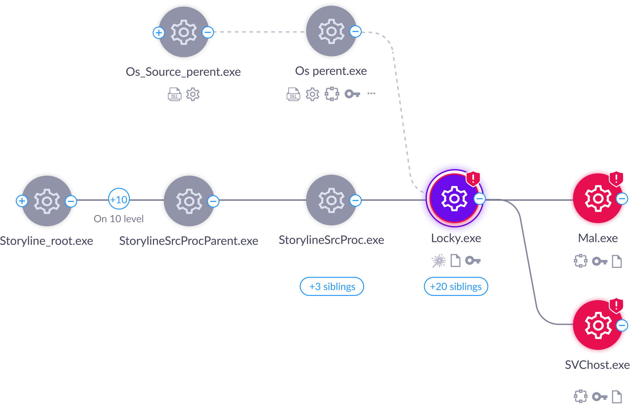







EDR Services
Endpoint Detection & Response (EDR),
A component of RSM Defense NG-XDR, enables rapid threat containment and accelerated recovery. By expanding detection beyond the endpoint context, RSM Defense makes any EDR more valuable.
Bring your own EDR OR Fully Managed Options.
Outcomes
Improve incident decision support for security operators with prescriptive remediation actions
Reduce Mean Time to Respond and Recover with robust native and 3rd-party responses
Automate uniform remediation & recovery across Windows, Mac, and Linux
Kill Process
Kill Container
Quarantine
Isolate Device
Binary capture
Remote Shell
Firewall Control
Device Control
K8s/Linux App Control
Storyline™ Automated
Context
Easy-to-Use Forensics & Root Cause Analysis
STAR™
Response Automation
1-Click Remediation & Rollback
On-demand
remote shell access

Slide 19
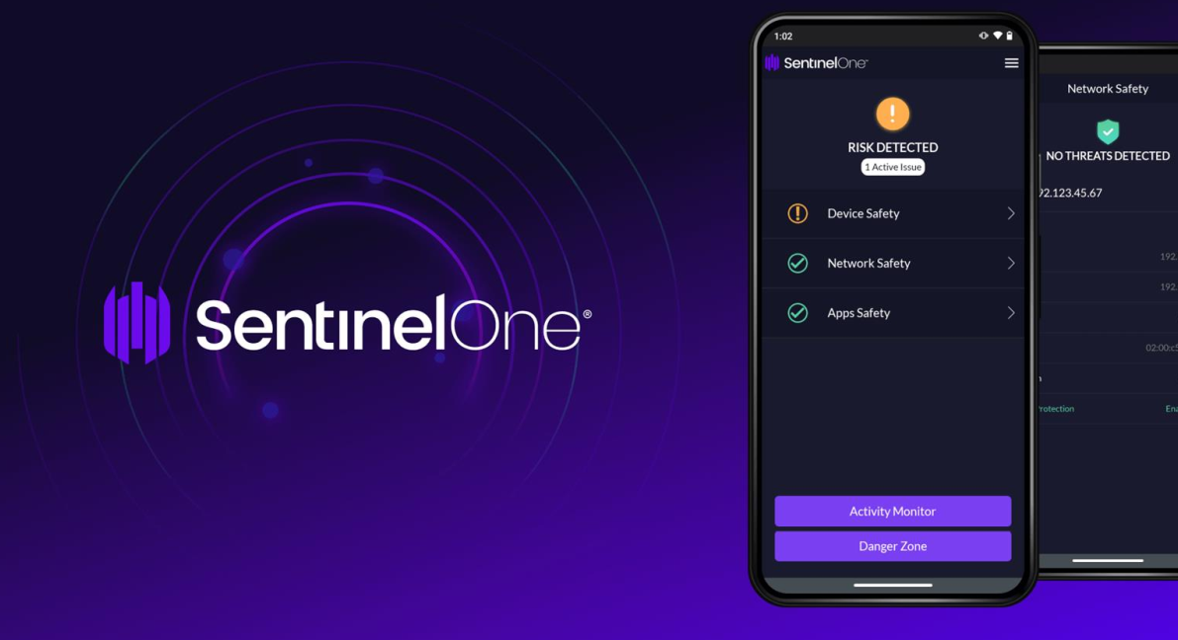

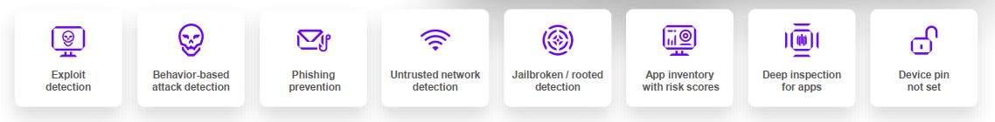
Mobile Threat Defense
RSM Defense is committed to cover all your attack surfaces, even mobile. Work happens anywhere at anytime and mobile is a critical component of how distributed and modern enterprises verify trust and identities, but mobile devices also access many of the same critical company data and resources that servers and endpoints do.
Easy to Manage
● Supports the major mobile platforms (iOS, Android, Chrome OS)
● Zero touch deployments
● Compatible with leading MDMs. However, MDM optional.
● Easy on batteries.
Autonomous AI Protection & Visibility
● On-device, real time, adaptive behavioral threat protection
● Known & unknown malware, phishing, exploits, MITM protection
● Supports conditional access & orchestrated response
Privacy by Design
● Balances data privacy with security
● BYOD safe. Never collects user (owner) content or messages.
● Can disable collection of app inventory and network details

Slide 20
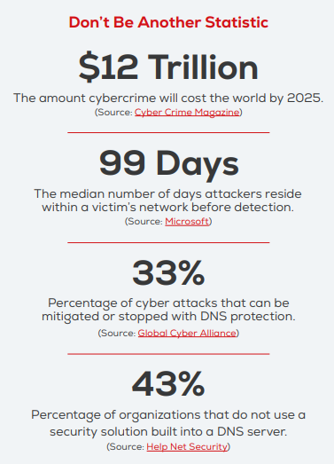
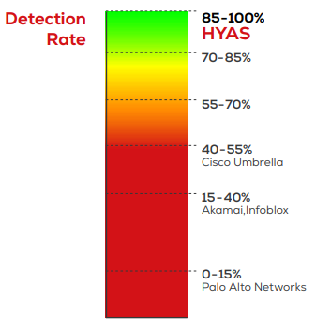
Protective DNS Services
RSM Defense has partnered with HYAS to further protect our clients, enforce security, and block command and control communication used by attackers.
HYAS collects DNS data and organizes it in a comprehensive database, providing you a crucial advantage in staying ahead of cyber criminals.
Outcomes
Deploys in seconds
DNS resolver – built-in support for DNSSEC, DNS over HTTPS, and DNS over TLS
Real-time native integrations with SentinelOne and Microsoft Defender for Endpoint
Windows, Mac, iOS, and Android coverage
Block harmful or inappropriate web content
How we protect your brand
Identify and block adversary infrastructure to thwart data breaches, ransomware, and other threats.
Monitor domain lifecycles through a comprehensive graph database, connecting malicious domains, IP addresses, and indicators of compromise.
Seamlessly integrate with EDR, XDR, SIEM, SOAR, and firewall systems to enhance threat detection and response capabilities.
Outperform other DNS solutions, achieving an impressive detection rate of 85-100% as validated by third-party evaluation from AV-TEST.

Slide 21
More About RSM Defense

Slide 22






Client realized benefits from RSM Defense platform
Scalability & coverage – 24/7/365 security operations, threat intel, and incident response & recovery
Predictability & cost savings - an all-inclusive monthly subscription pricing model
Personalized interaction with an industry focus and deep technical experience – eliminate the hassle of recruiting, managing, and retaining full-time security professionals
Infuse continuous intel into everyday security operations allowing for intelligent automated responses
Improve the visibility and reliability of your incident detection, response, and recovery activities

Slide 23





RSM Defense by the numbers
6000+
Cyberattacks identified and blocked weekly
3 RSM Defense cyber hubs across the globe
180+
Clients on the RSM Defense platform
35+ RSM Defense team members
200+ million
Events processed daily

Slide 24
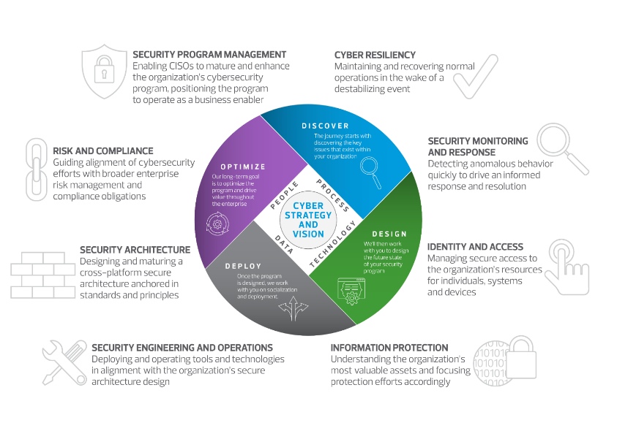

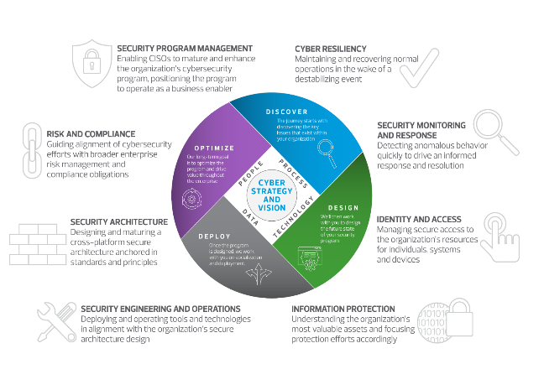

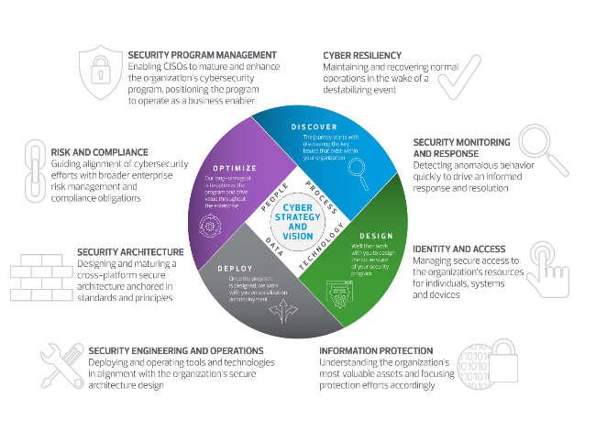



A Client Case Study
Security Program Management
Profile
Non-profit hospital system with 8 medical centers and 300+ clinics & centers supporting 1.8 million clinic visits annually
The challenge
NIST-based assessment identified significant gaps in cyber program. Board requested 6 month accelerated program to jumpstart cyber risk mitigation efforts through a portfolio of projects aimed at top risks.
Key pain points
Lack of consistent patching and vulnerability management processes
Significant # of unsupported IT assets
No defined return to service plan from systemic outage (e.g., ransomware)
Inconsistent and missing processes within continuity of operations plans
Limited insights from existing cyber event detection solutions (e.g., SIEM)
Gaps in hardened configuration of Azure cloud environment
Missing web app protections
Key client needs
Structure a PMO in order to orchestrate delivery of multiple security work streams under accelerated time frames. Provide subject matter experts to supplement existing cybersecurity organization and bring leading practice insights
Why RSM?
After receiving board approval, the CISO selected RSM for our ability to:
Depth of experience with program oversight, including facilitating steering committee sessions and day-to-day program management office (PMO) activities, and coordinating across 10 project work streams
Our understanding of client’s requirements and ability to bring cybersecurity transformation, operational experience, and managed security services
Ability to quick ramp-up and onboard to meet ambitious 6-month timeline
Results
Established program management framework to support current and future cyber efforts along with toolkit of templates and accelerators
Streamlined asset research with consolidation of 9 asset sources into a custom PowerBI tool
Defined methodology to disposition unsupported assets and applied to 45+ application and 240 hosts+.
Deployed RSM Defense for on-going vulnerability scanning of 20k+ assets.
Evaluated and piloted DDoS/WAF solution to protect 50+ web apps
Identified 50+ cloud configuration gaps and defined roadmap for remediation and future state preventative controls
Built roadmap to redesign continuity planning for all entities and defined steps to build an enterprise-wide COOP
Built roadmap for increased alert fidelity through addition of 20+ log sources. Designed over 100+ new alerts to warn of potential cyber attack.
Client background
Solution
Impact
Risk and Compliance
Security Architecture
Security Engineering & Operations
Information Protection
Identity and Access
Security Monitoring and Response
Cyber Resiliency
24

Slide 25
A Client Case Study
Security Program Management
Profile
Large regional credit union with 2,000 employees and $10 billion in assets.
The challenge
Client has limited IT and Security staff to handle infrastructure and security needs and was looking for a partner who could support them while they focus on business operations. Several acquisitions over the years have introduced significant amount of disparate technology which is costly to maintain.
Key pain points
No consolidated view on security threats
Lack of consistent patching and vulnerability management processes
Significant # of unmanaged IT assets from acquisitions
No defined return to service plan from systemic outage (e.g., ransomware)
Inconsistent and missing processes within continuity of operations plans
Gaps in hardened configuration of on-premises environments
Key client needs
Structure a PMO in order to orchestrate delivery of multiple security and technology infrastructure work streams under prescriptive time frames. Provide subject matter experts to supplement existing cybersecurity organization and bring leading practice insights
Why RSM?
After receiving board approval, the CIO selected RSM for our ability to:
Depth of experience with program oversight, including facilitating steering committee sessions and day-to-day program management office (PMO) activities, and coordinating across 8 project work streams
Our understanding of client’s requirements and ability to bring cybersecurity transformation, operational experience, and managed security services
Ability to quickly ramp-up and phase-in capability sets to meet ongoing business, audit, and operational needs
Results
Implemented robust program management framework to bolster current and future cyber initiatives.
Employed RSM Defense for continuous vulnerability scanning across 4K+ assets.
Configured and oversaw Office365 and Active Directory for 2K+ employees and third parties, enhancing identity protection and monitoring crucial business operations.
Managed firewalls and networking infrastructure, while facilitating end-of-support transitions to consolidate infrastructure and cut overall costs.
Drastically reduced resolution time for technical support issues on servers and end-user devices through expert L3 services.
Developed a roadmap to enhance alert accuracy, scaling from 1 to 40 sources of data/truth.
Seamlessly integrated threat intelligence into all investigations, further elevating alert accuracy and response capabilities.
Client background
Solution
Impact
Risk and Compliance
Security Architecture
Security Engineering & Operations
Information Protection
Identity and Access
Security Monitoring and Response
Cyber Resiliency
25

Slide 26

518 Township Line Road, Suite 300
Blue Bell, PA 19422
T 215.641.8600
rsmus.com
RSM US LLP
This document contains general information, may be based on authorities that are subject to change, and is not a substitute for professional advice or services. This document does not constitute audit, tax, consulting, business, financial, investment, legal or other professional advice, and you should consult a qualified professional advisor before taking any action based on the information herein. RSM US LLP, its affiliates and related entities are not responsible for any loss resulting from or relating to reliance on this document by any person. Internal Revenue Service rules require us to inform you that this communication may be deemed a solicitation to provide tax services. This communication is being sent to individuals who have subscribed to receive it or who we believe would have an interest in the topics discussed. RSM US LLP is a limited liability partnership and the U.S. member firm of RSM International, a global network of independent audit, tax and consulting firms. The member firms of RSM International collaborate to provide services to global clients, but are separate and distinct legal entities that cannot obligate each other. Each member firm is responsible only for its own acts and omissions, and not those of any other party. Visit rsmus.com/aboutus for more information regarding RSM US LLP and RSM International.
RSM, the RSM logo and The power of being understood are registered trademarks of RSM International Association, used under license.
© 2024 RSM US LLP. All Rights Reserved.

